Slide 1

A Comparative Analysis of Accuracies of Various Machine Learning Algorithms for Cardiovascular Disease Risk Prediction And Classification
EL)
Name – Subhankar Sen
Registration No.- 199301028
Section-G
Subject- Experiential Learning (EL)
Group-6
Mentor: Dilbagh Sir

Slide 2

A BRIEF INTRODUCTION
It is necessary to record the most important symptoms and health habits that contribute to Cardiovascular Diseases(CVD).
Various tests are performed prior to diagnosis of CVD, including auscultation, ECG, blood pressure, cholesterol and blood sugar.

Slide 3
OBJECTIVE OF THE PROJECT
The main objective of this article is the prediction heart disease using different classification algorithms such as Logistic Rgerssion ,K-Nearest Neighbors(KNN), Support Vector Machine(SVM) and Naïve Bayesian Algorithm .The evaluation metrics used is Confusion Matrix. These classification algorithms are applied to diagnose heart disease and measures the classification accuracy to evaluate the performance of characteristic selection methods.

Slide 4
Methodology
Import necessary libraries
Import Dataset .Read the datasets, the data should contain different variables like age ,sex, cp(chest pain),slope, target.
Data Visualization using histogram distribution and bar graph
Data Pre-processing: Here only Data Normalization is used. Data Cleaning was not required

Slide 5
The Machine Learning models used for the classification of cardiac diseases are as follows:
i.) Logistic Regression
ii.) Support Vector Machine(SVM)
iii.) K-Nearest Neighbors(KNN)
iv.) Naïve Bayesian Algorithm

Slide 6
Main Flowchart Diagram
start
Importing dataset
Data Pre-processing
Applying Classification Techniques
Logistic Regression
KNN
SVM
Naïve Bayes
Comparison of the accuracies of the ML models
end

Slide 7

Sub Flowchart Diagram
Training Dataset
Logistic Regression/KNN/SVM/Naïve Bayes Classifier
Testing Dataset
Heart Disease risk prediction

Slide 8

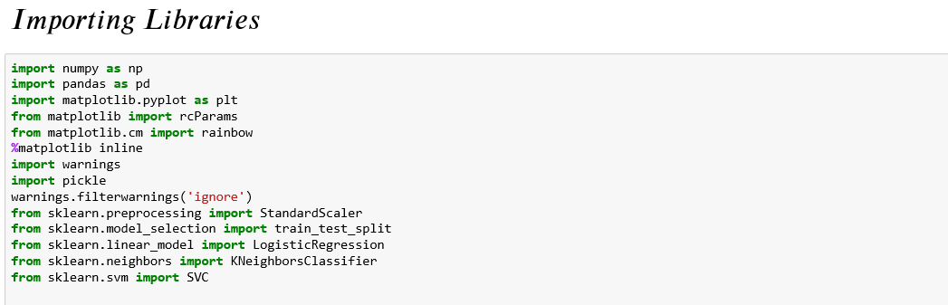
IMPORTING NECESSARY LIBRARIES

Slide 9

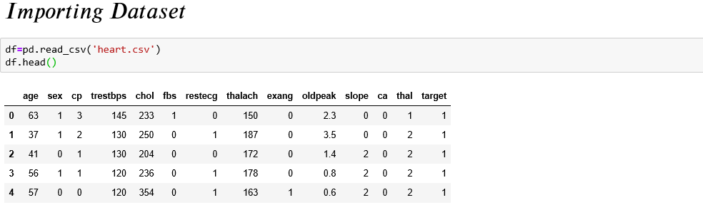
Heart disease Dataset

Slide 10
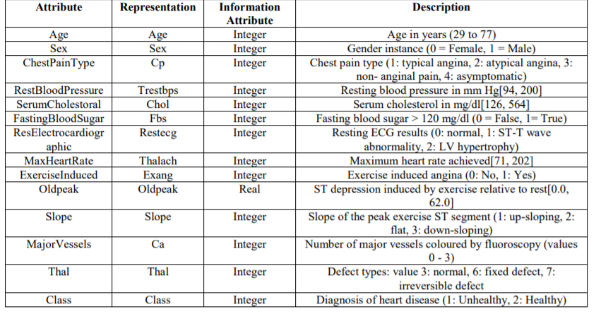
ATTRIBUTES OF THE DATASET

Slide 11
Data Visualization

Slide 12
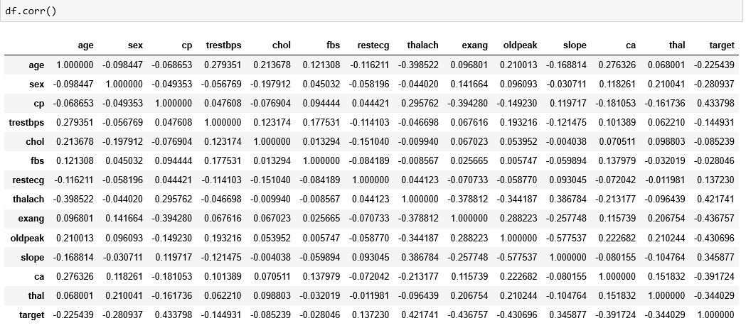
Correlation Matrix
corr() is used to find the pairwise correlation of all columns in the data frame df

Slide 13
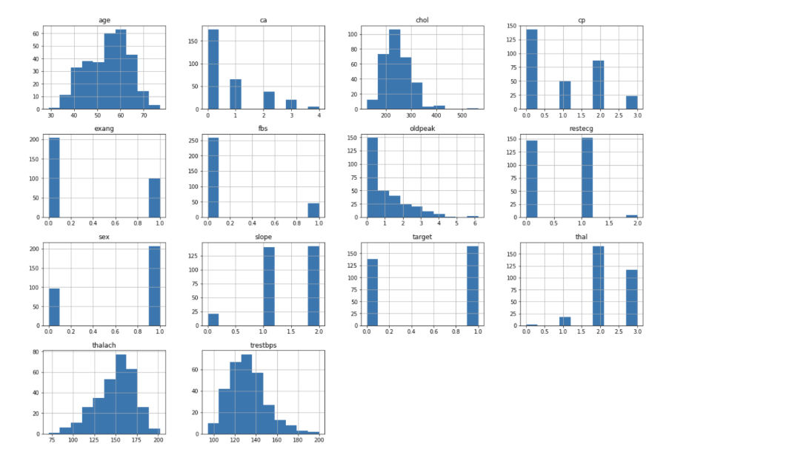
Histogram Distribution

Slide 14
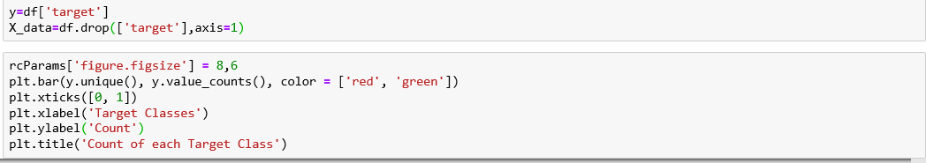
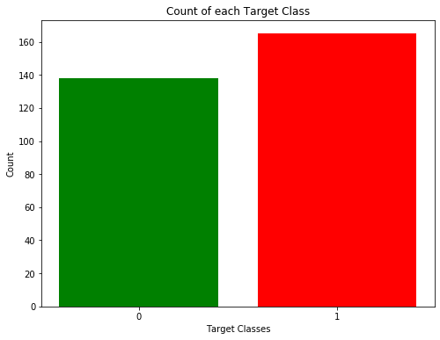

Slide 15

DATA PREPROCESSING

Slide 16
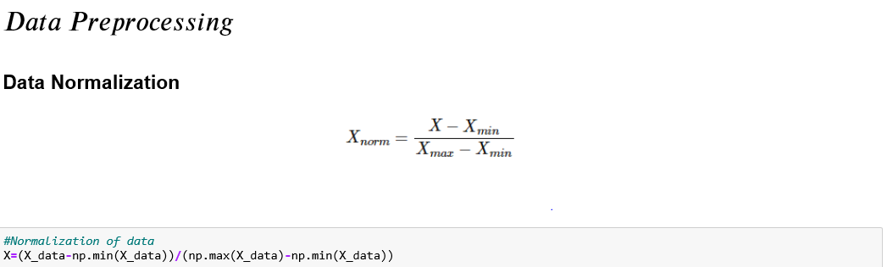

Slide 17
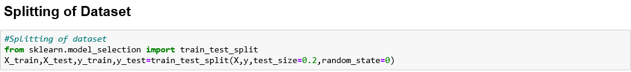

Slide 18

MACHINE LEARNING MODELS EMPLOYED

Slide 19
1) Logistic Regression
Logistic regression is a statistical model that in its basic form uses a logistic function to model a binary dependent variable, although many more complex extensions exist. Mathematically, a binary logistic model has a dependent variable with two possible values, such as pass/fail which is represented by an indicator variable, where the two values are labeled "0" and "1".
Types of Logistic Regression
1. Binary Logistic Regression
The categorical response has only two 2 possible outcomes. Example: Spam or Not
2. Multinomial Logistic Regression
Three or more categories without ordering. Example: Predicting which food is preferred more (Veg, Non-Veg, Vegan)

Slide 20
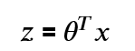
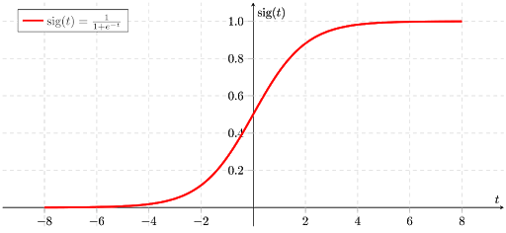
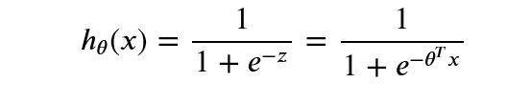
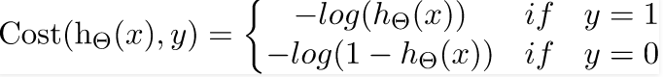
Sigmoid Function
Logistic Regression Cost Function

Slide 21
Logistic Regression Flowchart
start
Input the training and test data
computing the regression coefficients of training data
finding the relationship between the training and the test data
Output :prediction made on test data
end

Slide 22
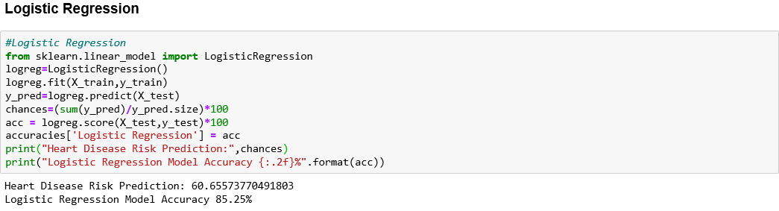
Heart Disease Risk Prediction: 60.655%
Test Accuracy Obtained using Logistic Regression : 85.25%

Slide 23
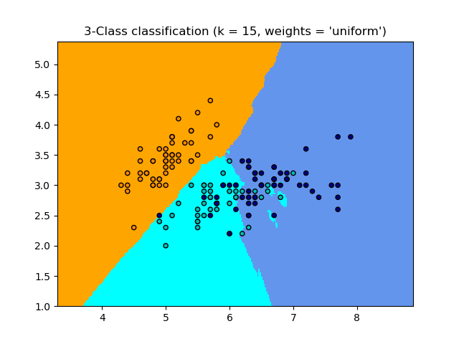
2) K-Nearest Neighbor (KNN)
K-nearest neighbors (KNN) algorithm is a type of supervised ML algorithm which can be used for both classification as well as regression predictive problems. However, it is mainly used for classification predictive problems in industry. The following two properties would define KNN well −
Lazy learning algorithm − KNN is a lazy learning algorithm because it does not have a specialized training phase and uses all the data for training while classification.
Non-parametric learning algorithm − KNN is also a non-parametric learning algorithm because it doesn’t assume anything about the underlying data.

Slide 24
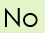
KNN FLOWCHART
start
Read the no. of clusters(k)
while i<=max_iter
Random initialization of the cluster centroids
Cluster assignment step((find the k nearest neighbors to the test data and set label class of k to the test data)
move cluster centroid step(Update the new position of the cluster centroids according to the cluster assignment step)
Best solution
end

Slide 25
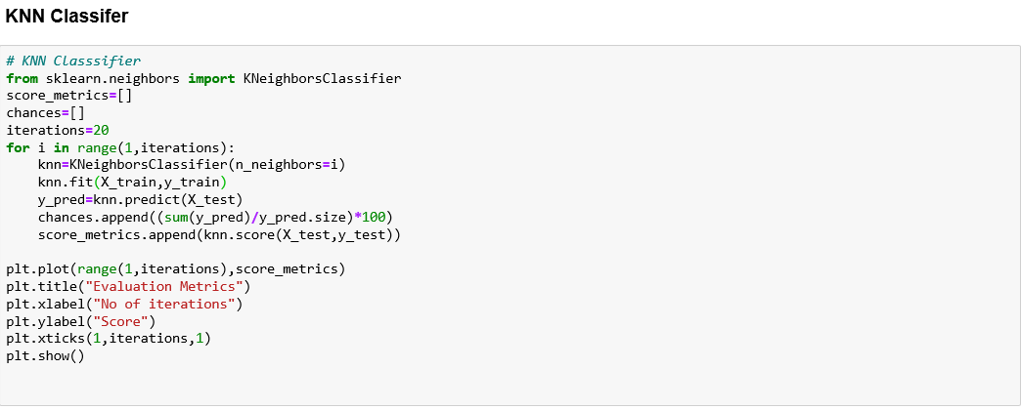

Slide 26
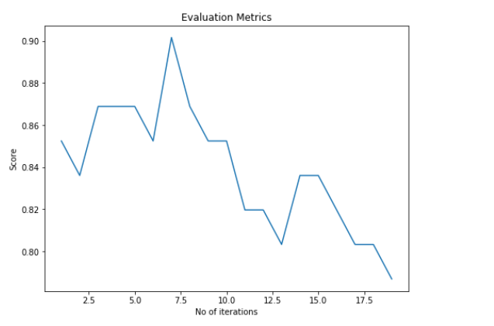

Slide 27
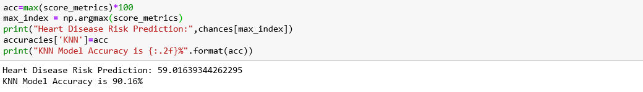
Heart Disease Risk Prediction: 59.016%
Test Accuracy obtained using KNN is: 90.16%

Slide 28
3) Support Vector Machine(SVM)

